Slide 1

Chapter - 1 Self-Assessment and Development Understanding Yourself to Grow Professionally and Personally
Sem-4 Professional Grooming & Personality Development (303193252)

Slide 2
Learning Objectives
By the end of this session, learners will be able to:
Understand the importance of self-assessment.
Identify personal strengths, weaknesses, and opportunities for growth.
Develop a structured plan for personal and professional development.
Utilize feedback effectively for self-improvement.

Slide 3
Topics to be Covered
1.Introduction
2.Importance of Self Development
3.Tools
4.Steps
5.Personal Development Plan
6.Activity
7.Conclusion
8.Learning outcome

Slide 4

Introduction
Theme Introduction
The slide introduces the theme of self-development and assessment, setting the tone for the presentation.
Importance of Growth
Emphasizes enhancing personal and professional skills for career growth and advancement.

Slide 5
Introduction
Self-assessment is the foundation for personal growth and professional development.
Regular reflection helps individuals align goals with strengths and address areas for improvement.
Development plans ensure structured and measurable progress.

Slide 6
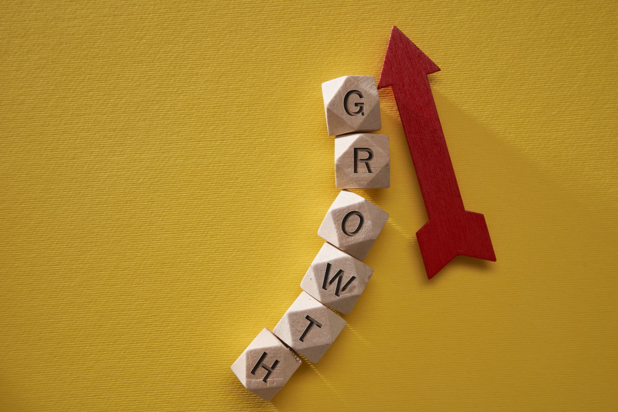
Importance of Self-Development
Enhances self-awareness and decision-making.
Identifies skill gaps for professional growth.
Encourages accountability and proactive learning.
Supports career planning and continuous improvement.

Slide 7
Tools for Self-Assessment
SWOT Analysis (Strengths, Weaknesses, Opportunities, Threats)
Personality Tests (MBTI, DISC)
Skills and Competency Inventories
Feedback from peers, mentors, and supervisors
Journaling and reflective exercises

Slide 8
Steps in Self-Assessment
Reflect on past experiences and achievements.
Collect feedback from trusted sources.
Analyze results to identify gaps and strengths.
Set goals for skill improvement and growth.
Implement actions and monitor progress.

Slide 9

Personal Development Plan (PDP)
Define short-term and long-term goals.
Identify skills to improve and actions to take.
Set timelines and milestones for each goal.
Review and adjust the plan regularly.

Slide 10

Continuous Learning Strategies
Attend workshops and training programs.
Engage in online courses and webinars.
Read books and industry publications.
Apply new skills in real-life scenarios.

Slide 11
Feedback and Reflection
Seek constructive feedback from mentors and peers.
Reflect on lessons learned from successes and failures.
Adjust personal development strategies accordingly.
Document progress to maintain accountability.

Slide 12

Assessment Techniques
Self-rating scales and questionnaires
Peer evaluation and 360-degree feedback
Performance reviews and reflections
Tracking KPIs or personal milestones

Slide 13
Role Play / Activity
Activity: “Identify your top 3 strengths and areas to improve.” Group Discussion: “How feedback helped you grow professionally.” Exercise: Draft your Personal Development Plan for the next 6 months.

Slide 14

Engagement Strategies
Icebreaker: Self-reflection questionnaire
Group sharing: Lessons learned from past experiences
Peer mentoring discussion
Video analysis of professional growth examples

Slide 15
Reflection Question
“Which personal or professional habit do you need to change to grow effectively?”

Slide 16
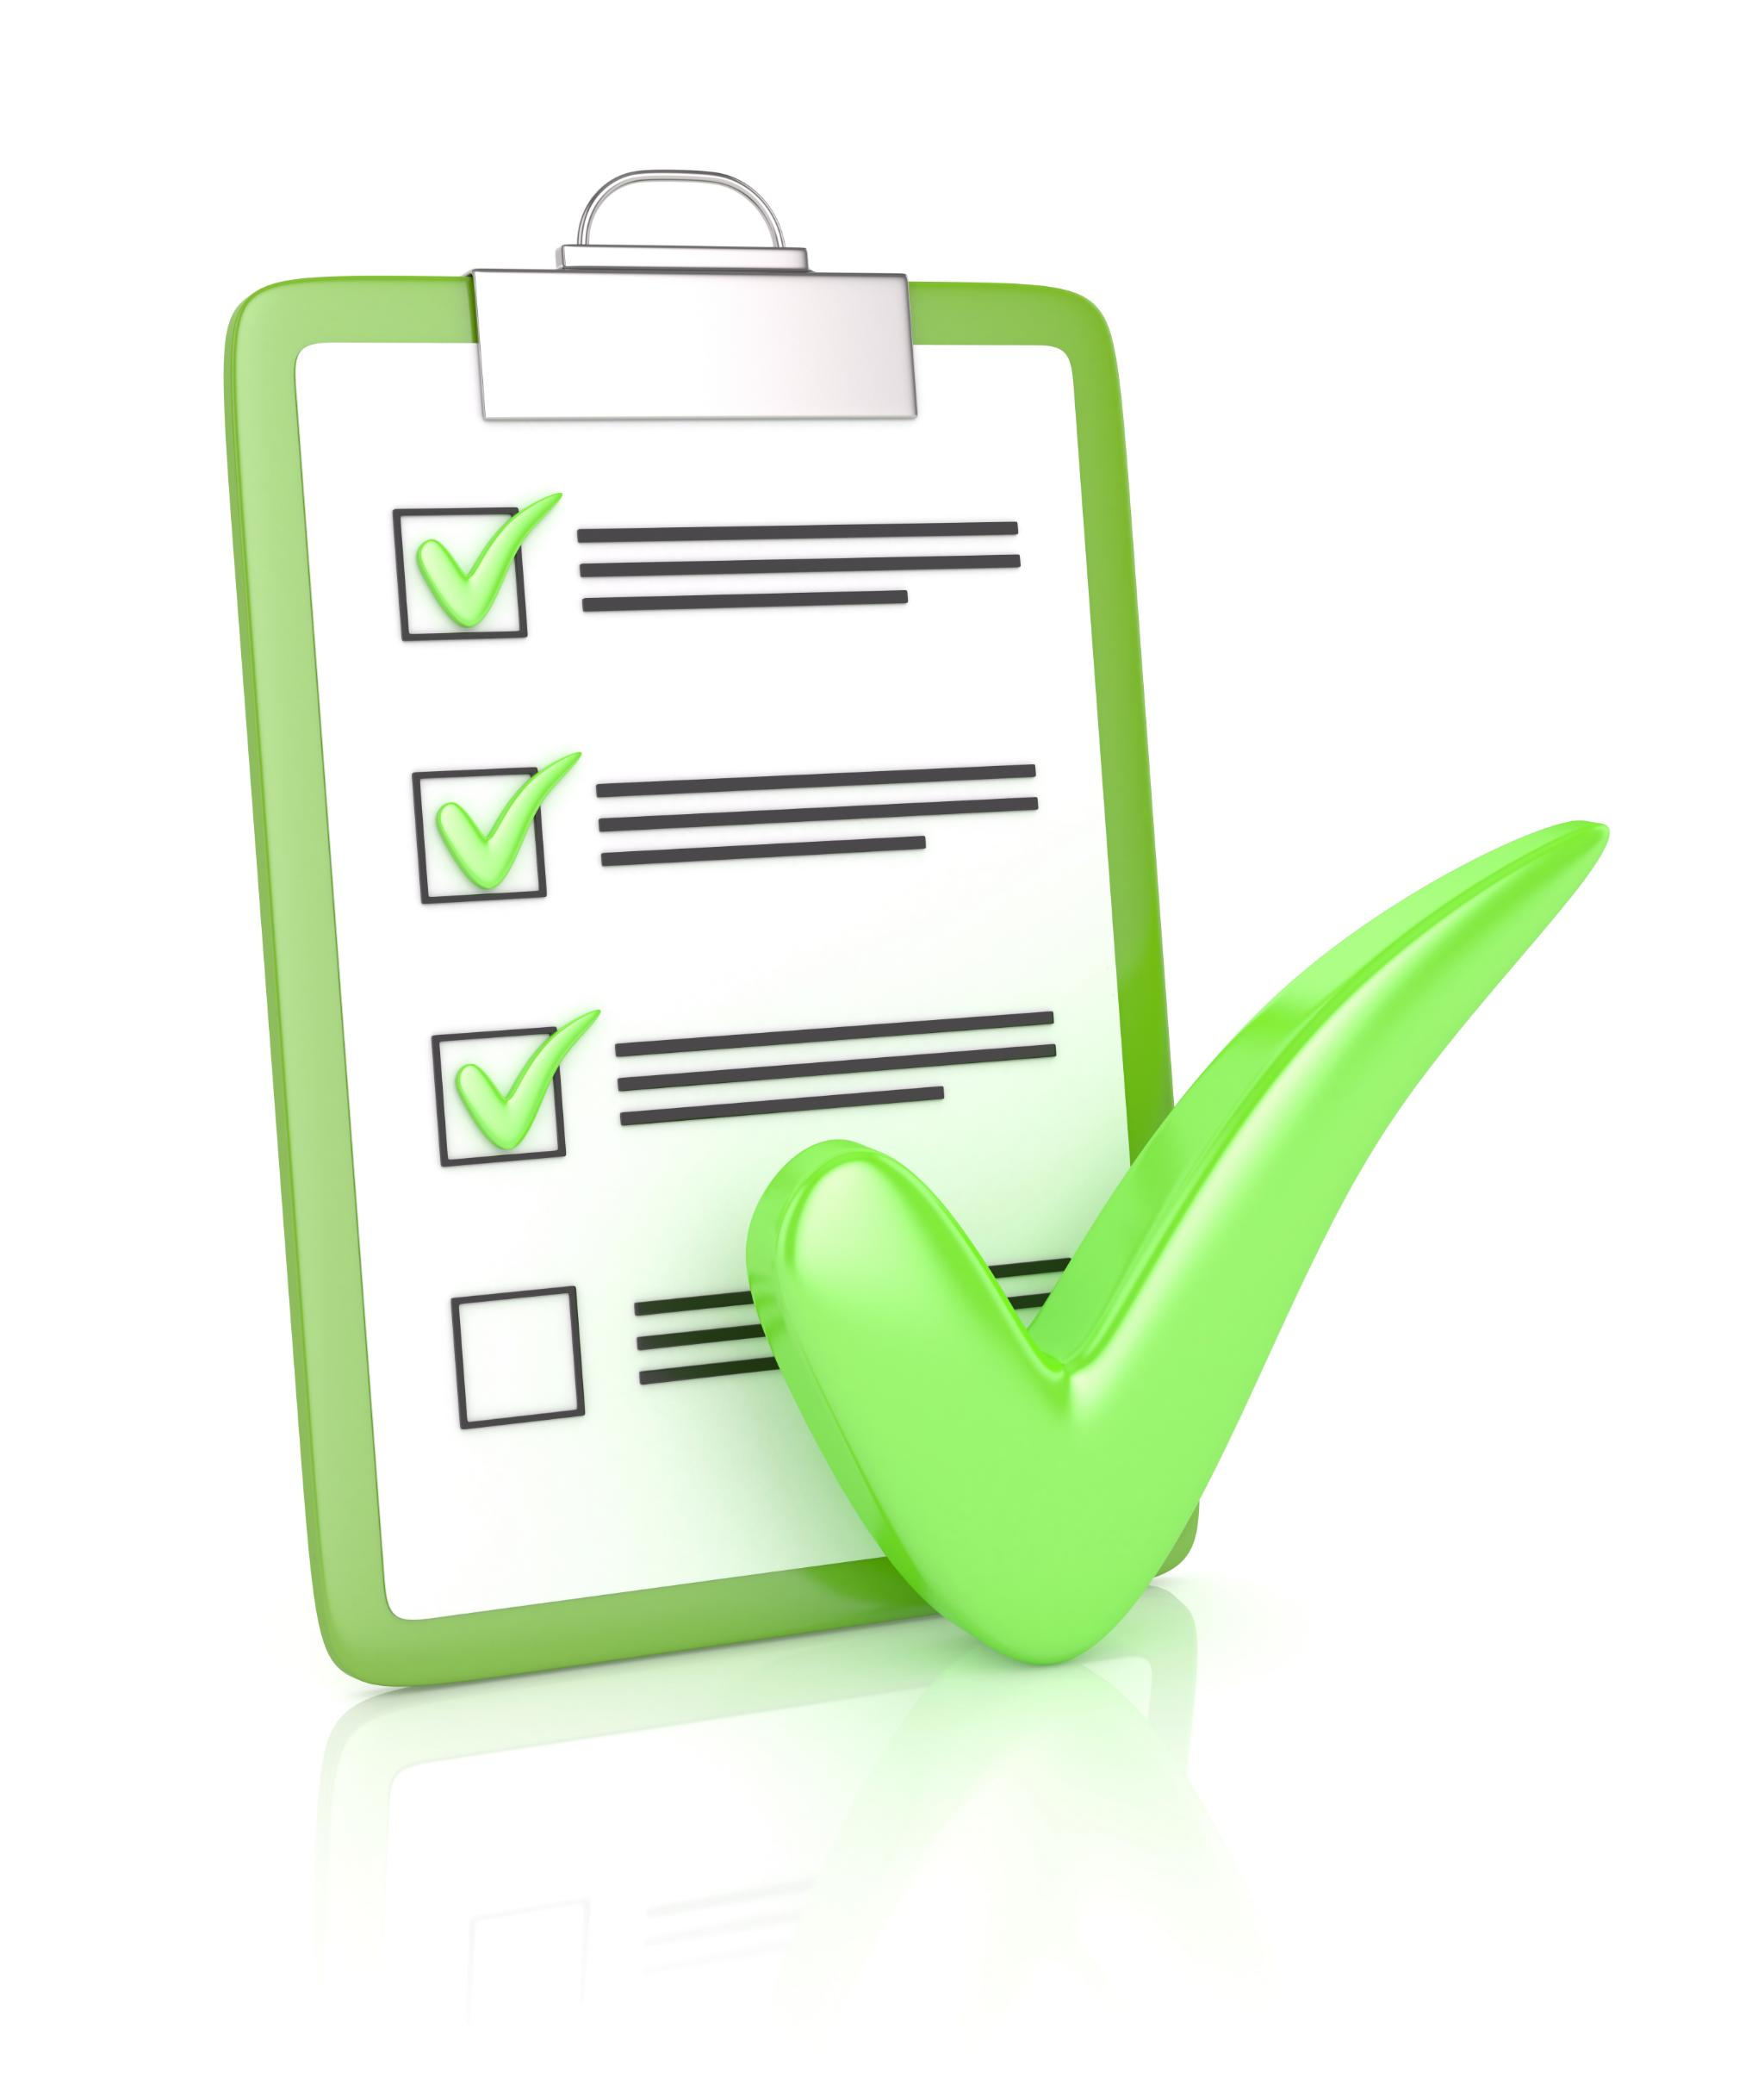
References
Stephen Covey – The 7 Habits of Highly Effective People
Dale Carnegie – How to Develop Self-Confidence and Influence People
MindTools.com – Personal Development & Self-Assessment Resources
Harvard Business Review – Self-Assessment and Growth Articles

Slide 17
Video Links
https://youtu.be/MDxIHzI66Os?si=B_MC_VTumac4Fir
https://youtu.be/QOXLmF0wvOY?si=6HyLmaQD2PQsPbpu
https://youtu.be/2UAYoj4pelk?si=bHqI4u_Qk5DlZYeB
https://youtu.be/uvtXuxl7KXI?si=qkuMD0Bk60aC9Z4r
https://youtu.be/8I99KX-Vlf4?si=iRMpVGua6v8Oulh4

Slide 18

Learning Outcomes
After completing the session, students will:
Recognize their personal and professional skills.
Demonstrate self-reflection and goal setting.
Apply tools and methods for continuous self-improvement.
Build confidence and adaptability in various environments.

Slide 19
Conclusion
Self-assessment is a continuous journey for growth.
Reflection and feedback are key to improvement.
A structured development plan ensures measurable progress and career success.

Slide 20
Thank You

